Slide 1
CHAPTER 11 Managing Internal Operations: Actions That Promote Good Strategy Execution

Slide 2
LEARNING OBJECTIVES
THIS CHAPTER WILL HELP YOU UNDERSTAND:
Why resource allocation should always be based on strategic priorities
How well-designed policies and procedures can facilitate good strategy execution
How best practices and process management tools drive continuous improvement in the performance of value chain activities and promote superior strategy execution
The role of information and operating systems in enabling company personnel to carry out their strategic roles proficiently
How and why the use of well-designed incentives and rewards can be management’s single most powerful tool for promoting adept strategy execution

Slide 3
PROMOTING GOOD STRATEGY EXECUTION
Allocating ample resources to execution-critical value chain activities
Instituting policies and procedures that facilitate good strategy execution
Employing process management tools to drive continuous improvement in how value chain activities are performed
Installing information and operating systems that enable company personnel to carry out their strategic roles proficiently
Using rewards and incentives to promote better strategy execution and the achievement of strategic and financial targets

Slide 4
ALLOCATING RESOURCES TO THE STRATEGY EXECUTION EFFORT
Possible adverse resource allocation outcomes
Too little funding that slows progress and impedes the efforts of organizational units to execute their pieces of the strategic plan proficiently
Too much funding that wastes organizational resources and reduces financial performance

Slide 5
STRATEGIC MANAGEMENT PRINCIPLE (1 of 14)
The funding requirements of good strategy execution must drive how capital allocations are made and the size of each unit’s operating budget. Underfunding organizational units and activities pivotal to the strategy impedes successful strategy implementation.

Slide 6
STRATEGY-DRIVEN BUDGETING: ALLOCATING RESOURCES
Screen resource requests carefully
Approve only those that contribute to strategy execution
Provide the level of resources necessary for the success of strategic initiatives
Shift resources to higher-priority activities where new execution initiatives are needed

Slide 7
Strategic Management Principle (2 of 14)
A company’s operating budget must be both strategy-driven (in order to amply fund the performance of key value chain activities) and lean (in order to operate as cost-effectively as possible).

Slide 8
INSTITUTING POLICIES AND PROCEDURES THAT FACILITATE STRATEGY EXECUTION
Policies and operating procedures facilitate strategy execution by:
Providing top-down guidance regarding how things need to be done
Helping ensure consistency in how execution-critical activities are performed
Promoting the creation of a work climate that facilitates good strategy execution

Slide 9
Strategic Management Principle (3 of 14)
A company’s policies and procedures provide a set of well-honed routines for running the company and executing the strategy.

Slide 10
Strategic Management Principle (4 of 14)
Well-conceived policies and procedures aid strategy execution; out-of-sync ones hinder effective execution.
There is wisdom in a middle-ground approach: Prescribe enough policies to give organization members clear direction and to place reasonable boundaries on their actions; then empower them to act within these boundaries in pursuit of company goals.

Slide 11
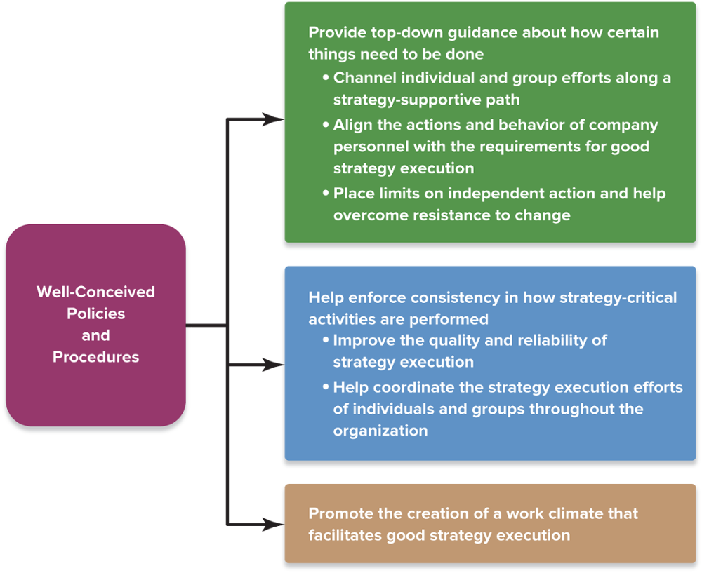
FIGURE 11.1 How Policies and Procedures Facilitate Good Strategy Execution
Jump to Appendix 1 long image description

Slide 12
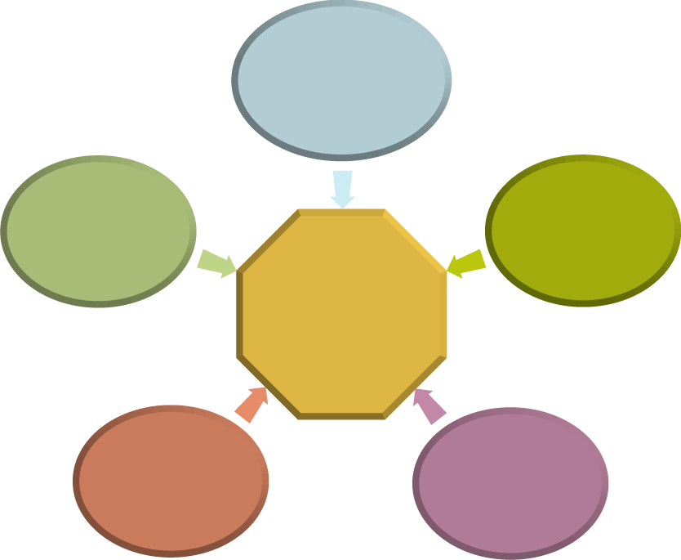
ADOPTING BEST PRACTICES AND EMPLOYING PROCESS MANAGEMENT TOOLS
Benchmarking
Best practices
Process reengineering
Managing for Continuous Improvement
Total quality management (TQM)
Six Sigma quality programs
Jump to Appendix 2 long image description

Slide 13
Core Concept (1 of 5)
A best practice is a method of performing an activity that consistently delivers superior results compared to other approaches.

Slide 14
Strategic Management Principle (5 of 14)
Wide-scale use of best practices across a firm’s entire value chain promotes operating excellence and good strategy execution.
The more that organizational units use best practices in performing their work, the closer a company comes to achieving effective and efficient strategy execution.

Slide 15
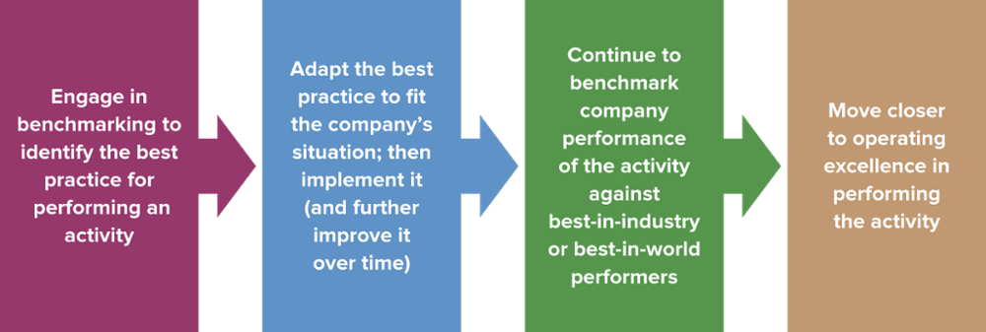
FIGURE 11.2 From Benchmarking and Best-Practice Implementation to Operating Excellence in Strategy Execution
The more that organizational units use best practices in performing their work, the closer a company moves toward performing its value chain activities as effectively and efficiently as possible.
This is what excellent strategy execution is all about.
Jump to Appendix 3 long image description

Slide 16
BUSINESS PROCESS REENGINEERING, TOTAL QUALITY MANAGEMENT, AND SIX SIGMA QUALITY PROGRAMS: TOOLS FOR PROMOTING OPERATING EXCELLENCE
Business process reengineering:
Involves radically redesigning and streamlining work effort, flows and processes to achieve dramatic improvements in performance
Uses cross-functional teams, cutting-edge technology and information systems to reset and refocus the organization’s strategy

Slide 17
CORE CONCEPT (2 of 5)
Business process reengineering involves radically redesigning and streamlining how an activity is performed, with the intent of achieving quantum improvements in performance.

Slide 18
ACHIEVING CONTINUOUS IMPROVEMENT
Total Quality Management (TQM ):
Entails creating a total quality culture, involving managers and employees at all levels, bent on continuously improving the performance of every task and value chain activity.
Is a long-term race without a finish in which success comes slowly in small steps forward (kaizen)

Slide 19
CORE CONCEPT (3 of 5)
Total quality management (TQM) entails creating a total quality culture, involving managers and employees at all levels, bent on continuously improving the performance of every value chain activity.

Slide 20
A STATISTICAL APPROACH TO ACHIEVING CONTINUOUS IMPROVEMENT
Six Sigma quality control programs:
Utilize statistical methods to improve quality by reducing defects and variability in business processes
Six Sigma principles
All work is a process
All processes have variability
All processes create data that explain variability

Slide 21
Core Concept (4 of 5)
Six Sigma programs utilize advanced statistical methods to improve quality by reducing defects and variability in the performance of business processes.

Slide 22
SIX SIGMA AND NEW PROJECTS: DMADV
Define | What are our project goals and customer requirements?
Measure | How do we measure and determine both our goals and the needs of our customers?
Analyze | What existing process options do we have for meeting customer needs?
Design | Should we use an old or new process to meet customer needs and specifications?
Verify | How will we verify design performance and our ability to meet customer needs?

Slide 23
EXISTING PROCESSES AND SIX SIGMA: DMAIC
Define | Define what constitutes a defect or variation
Measure | Collect data to find out why, how, and how often this defect occurs
Analyze | Determine when, why, and where the defect is occurring
Improve | Implement best practice to eliminate defect or variation
Control | Implement training, monitoring and controls to sustain the improvement

Slide 24
Charleston Area Medical Center’s Six Sigma Program
How does CAMC’s Six Sigma program support its attempt to control costs and improve its competitive position?
Why is Six Sigma a necessity for achieving continuous improvement and operating excellence?
How does the Six Sigma process change an organization’s culture?

Slide 25
Strategic Management Principle (6 of 14)
Ambidextrous organizations are adept at employing continuous improvements in operating processes while allowing R&D to operate under a set of rules that allows for exploration and the development of breakthrough innovations.

Slide 26


THE DIFFERENCE BETWEEN BUSINESS PROCESS REENGINEERING AND CONTINUOUS IMPROVEMENT
Top-notch Strategy Execution and Operating Excellence
Business Process Reengineering
Continuous Improvement (TQM, Six Sigma)
Aims at one-time quantum improvement
Aims at ongoing incremental improvements
Jump to Appendix 4 long image description

Slide 27
Strategic Management Principle (7 of 14)
Business process reengineering aims at one-time quantum improvement, while continuous improvement programs like TQM and Six Sigma aim at ongoing incremental improvements.

Slide 28
CAPTURING THE BENEFITS OF INITIATIVES TO IMPROVE OPERATIONS
Action Steps to Realize the Value of TQM and Six Sigma Initiatives
Committing to total quality and continuous improvement
Emphasizing the necessity for improved performance
Empowering all employees to improve quality
Fostering quality-supportive behaviors
Using online systems to speed the adoption of best practices
Jump to Appendix 5 long image description

Slide 29
FOSTERING QUALITY-SUPPORTIVE BEHAVIORS
Screening job applicants rigorously and hiring only those with attitudes and aptitudes that are right for quality-based performance
Providing quality training for employees
Using teams and team-building exercises to reinforce and nurture individual effort
Recognizing and rewarding individual and team efforts to improve quality regularly and systematically
Stressing prevention (doing it right the first time), not correction (instituting ways to undo or overcome mistakes)

Slide 30
STRATEGIC MANAGEMENT PRINCIPLE (8 of 14)
The purpose of using benchmarking, best practices, business process reengineering, TQM, and Six Sigma programs is to improve the performance of strategy-critical activities and thereby enhance strategy execution.

Slide 31
INSTALLING INFORMATION AND OPERATING SYSTEMS
Benefits of information technologies
Enable better strategy execution through data-based decisions
Strengthen organizational capabilities
Allow for real-time tracking of implementation initiatives and daily operations
Provide monitoring of empowered employee performance (electronic scorecards)
Build closer relationships with customers

Slide 32
INSTITUTING ADEQUATE INFORMATION SYSTEMS PERFORMANCE TRACKING AND CONTROLS
Key Strategic Performance Indicators Tracked by Information Systems
Customer data
Financial performance data
Employee data
Operations data
Supplier/partner/ collaborative ally data
Jump to Appendix 6 long image description

Slide 33
Strategic Management Principle (9 of 14)
Having state-of-the-art operating systems, information systems, and real-time data is integral to superior strategy execution and operating excellence.

Slide 34
USING REWARDS AND INCENTIVES TO PROMOTE BETTER STRATEGY EXECUTION
Providing incentives and engaging in motivational practices that facilitate good strategy execution
Techniques for winning sustained, energetic commitment of employees to the strategy execution process
Striking the right balance between rewards and punishment for individual performance
Linking employee rewards to strategically relevant organizational performance outcomes
Jump to Appendix 7 long image description

Slide 35
Strategic Management Principle (10 of 14)
A properly designed reward structure is management’s most powerful tool for mobilizing organizational commitment to successful strategy execution and aligning efforts throughout the organization with strategic priorities.

Slide 36
Core Concept (5 of 5)
Financial rewards provide high-powered incentives when rewards are tied to specific outcome objectives.

Slide 37
NONMONETARY APPROACHES TO ENHANCING MOTIVATION
Provide attractive perks and fringe benefits
Give awards and other forms of public recognition
Rely on promotion from within whenever possible
Invite and act on ideas and suggestions
Create a work atmosphere of caring and mutual respect
State the strategic vision in inspirational terms
Share the firm’s critical information with employees
Provide a comfortable working environment

Slide 38


STRIKING THE RIGHT BALANCE BETWEEN REWARDS AND PUNISHMENT
The firm’s motivational approaches and reward structure
Rewards
Punishment
Commitment-generating incentives and rewards
Adverse employment consequences
Performance
Jump to Appendix 8 long image description

Slide 39
HOW THE BEST COMPANIES TO WORK FOR MOTIVATE AND REWARD EMPLOYEES
The times they are changing: Why are companies finding it increasingly necessary to motivate and reward workers to achieve higher levels of performance?
As businesses continue to globalize, how will companies have to adapt their reward and incentive systems?

Slide 40
Strategic Management Principle (11 of 14)
Incentives must be based on accomplishing the right results, not on dutifully performing assigned tasks.

Slide 41
LINKING REWARDS TO STRATEGICALLY RELEVANT PERFORMANCE OUTCOMES
Focus on and reward results, not effort
Create a results-oriented work environment that focuses on what to achieve, not what to do
Set strategically-relevant, specific, and measurable stretch performance goals that are difficult but achievable
Link the performance goals of each individual in an organizational unit to the unit’s goals
Reward and recognize as success superior performance in accomplishing the goals

Slide 42
STRATEGIC MANAGEMENT PRINCIPLE (12 of 14)
The key to creating a reward system that promotes good strategy execution is to make measures of good business performance and good strategy execution the dominating basis for designing incentives, evaluating individual and group efforts, and handing out rewards.

Slide 43
Strategic Management Principle (13 of 14)
The first principle in designing an effective incentive compensation system is to tie rewards to performance outcomes that are directly linked to good strategy execution and to the achievement of financial and strategic objectives.

Slide 44
GUIDELINES FOR DESIGNING EFFECTIVE INCENTIVE COMPENSATION SYSTEMS
Make financial incentives a major, not minor, piece of the total compensation package
Have incentives that extend to all managers and all workers, not just top management
Administer the reward system with scrupulous objectivity and fairness
Ensure that the performance targets set for each individual or team involve outcomes that the individual or team can personally affect
Keep the time between achieving performance target and receiving the reward as short as possible
Avoid rewarding effort rather than results

Slide 45
Nucor Corporation: Tying Incentives Directly to Strategy Execution
Tying incentives directly to strategy execution works when management has chosen the right strategy; what happens when the choice of strategy turns out to be seriously wrong?
What happens to employee morale and loyalty when a low-cost leadership firm achieves higher productivity at both its lower and higher wage locations and then needs to expand its production output? (productivity ≠ profitability).

Slide 46
Strategic Management Principle (14 of 14)
The unwavering standard for judging whether individuals, teams, and organizational units have done a good job must be whether they meet or beat performance targets that reflect good strategy execution.

Slide 47
Appendix 1 Figure 11.1 How Policies and Procedures Facilitate Good Strategy Execution
Well-conceived policies and procedures:
Provide top-down guidance about how certain things need to be done (such as by channeling individual and group efforts along a strategy-supportive path, by aligning the actions and behavior of company personnel with the requirements for good strategy execution, and by placing limits on independent action and help overcome resistance to change)
Help enforce consistency in how strategy-critical activities are performed (such as by improving the quality and reliability of strategy execution and by helping coordinate the strategy execution efforts of individuals and groups throughout the organization)
Promote the creation of a work climate that facilitates good strategy execution
Return to slide

Slide 48
Appendix 2 Adopting Best Practices and Employing Process Management Tools
Benchmarking, process reengineering, Six Sigma quality programs, total quality management (TQM) and best practices are all ways for managing for continuous improvement.
Return to slide

Slide 49
Appendix 3 Figure 11.2 From Benchmarking and Best-Practice Implementation to Operating Excellence in Strategy Execution
The four steps necessary to go from benchmarking and best-practice implementation to operating excellence are:
Engage in benchmarking to identify the best practice for performing an activity
Adapt the best practice to fit the company's situation; then implement it (and further improve it over time)
Continue to benchmark company performance of the activity against best-in-industry or best-in-world performers
Move closer to operating excellence in performing the activity
The more that organizational units use best practices in performing their work, the closer a company moves toward performing its value chain activities as effectively and efficiently as possible.
This is what excellent strategy execution is all about.
Return to slide

Slide 50
Appendix 4 The Difference Between Business Process Reengineering and Continuous Improvement
Both business process reengineering (which aims at one-time quantum improvement) and continuous improvement (for example, TQM and Six Sigma, which aim at ongoing incremental improvements) can lead to top-notch strategy execution and operating excellence.
Return to slide

Slide 51
Appendix 5 Capturing the Benefits of Initiatives to Improve Operations
Five action steps that can be taken to realize the value of TQM and Six Sigma Initiatives are:
Committing to total quality and continuous improvement
Fostering quality-supportive behaviors
Empowering all employees to improve quality
Using online systems to speed the adoption of best practices
Emphasizing the necessity for improved performance
Return to slide

Slide 52
Appendix 6 Instituting Adequate Information Systems Performance Tracking, and Controls
Key strategic performance indicators tracked by information systems are: customer data, operations data, employee data, supplier/partner/collaborative ally data, and financial performance data.
Return to slide

Slide 53
Appendix 7 Using Rewards and Incentives to Promote Better Strategy Execution
Three techniques for winning sustained, energetic commitment of employees to the strategy execution process are:
Providing incentives and engaging in motivational practices that facilitate good strategy execution
Striking the right balance between rewards and punishment for individual performance
Linking employee rewards to strategically relevant organizational performance outcomes
Return to slide

Slide 54
Appendix 8 Striking the Right Balance Between Rewards and Punishment
Two motivational approaches a firm can take toward affecting employee performance are rewards (consisting of commitment-generating incentives and rewards) or punishment (which consists of adverse employment consequences).
Return to slide

